Slide 1
Lesson 13 - Key Events
Mr Mack 2019

Slide 2
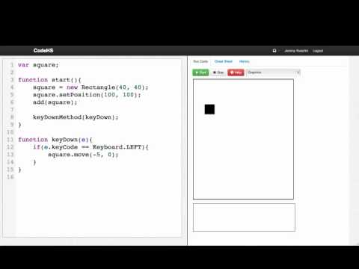

Slide 3
Example: Keyboard Square
This is an example for this lesson. You are encouraged to play around with it, run and change the code, and learn how it works. When you are done, click continue to go to the next problem.

Slide 4
Exercise 3.13.1: Basic Snake
Write a basic version of the snake game.
The way our game works is by first creating a green square at the center of the screen. The snake should be moving to the right. If you hit an arrow key, you should change the snake’s direction.
Hints
You are going to need some way to keep track of the snake’s current direction between functions!
Use constants!
When a key is pressed, if it is an arrow key, change the direction of the snake.

Slide 5
Exercise 3.13.2: Drag and Drop
Your job is to write a program that lets you move circles around the screen by dragging and dropping them. When you click your mouse down on a circle, it should select that circle and move the circle wherever you drag your mouse. It should stop moving when you let go of the mouse button.
We gave you the drawCircles function that will draw some circles. You just need to make drag and drop work.
You’ll need to use mouseDownMethod, mouseDragMethod, and possibly mouseUpMethod.
You’ll also have to use the getElementAt function.
Hint: You can set a variable to be null and check if a variable is not null by writing:
if (myVariable != null)

